Slide 1
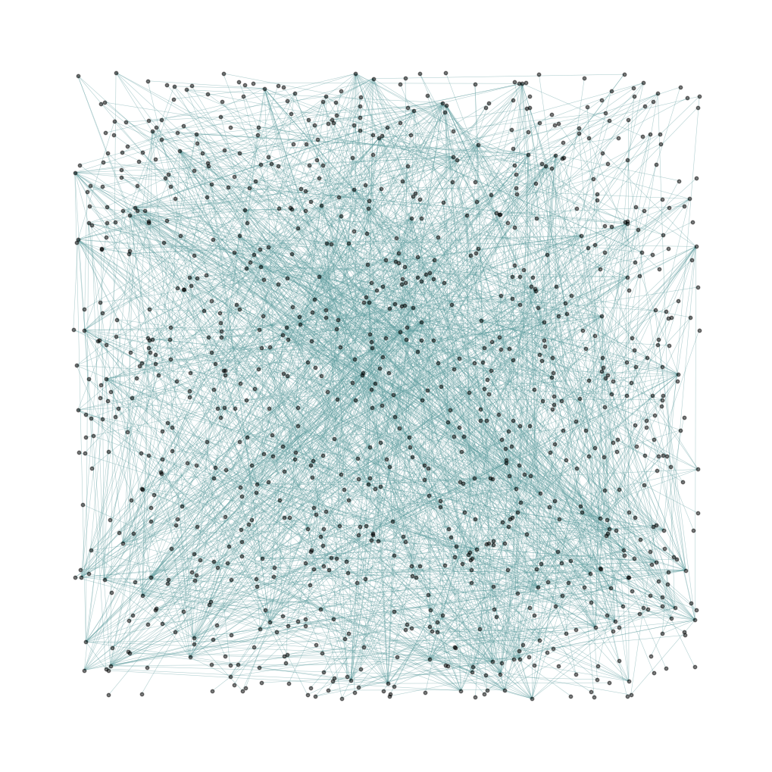
Spotify artists and genres network
Azim Chyngozhoev 20212003

Slide 2

Objective
Build a network of artists that worked together
Get a sneak peak into genre distribution of mainstream music
Measurements and characterization of network

Slide 3
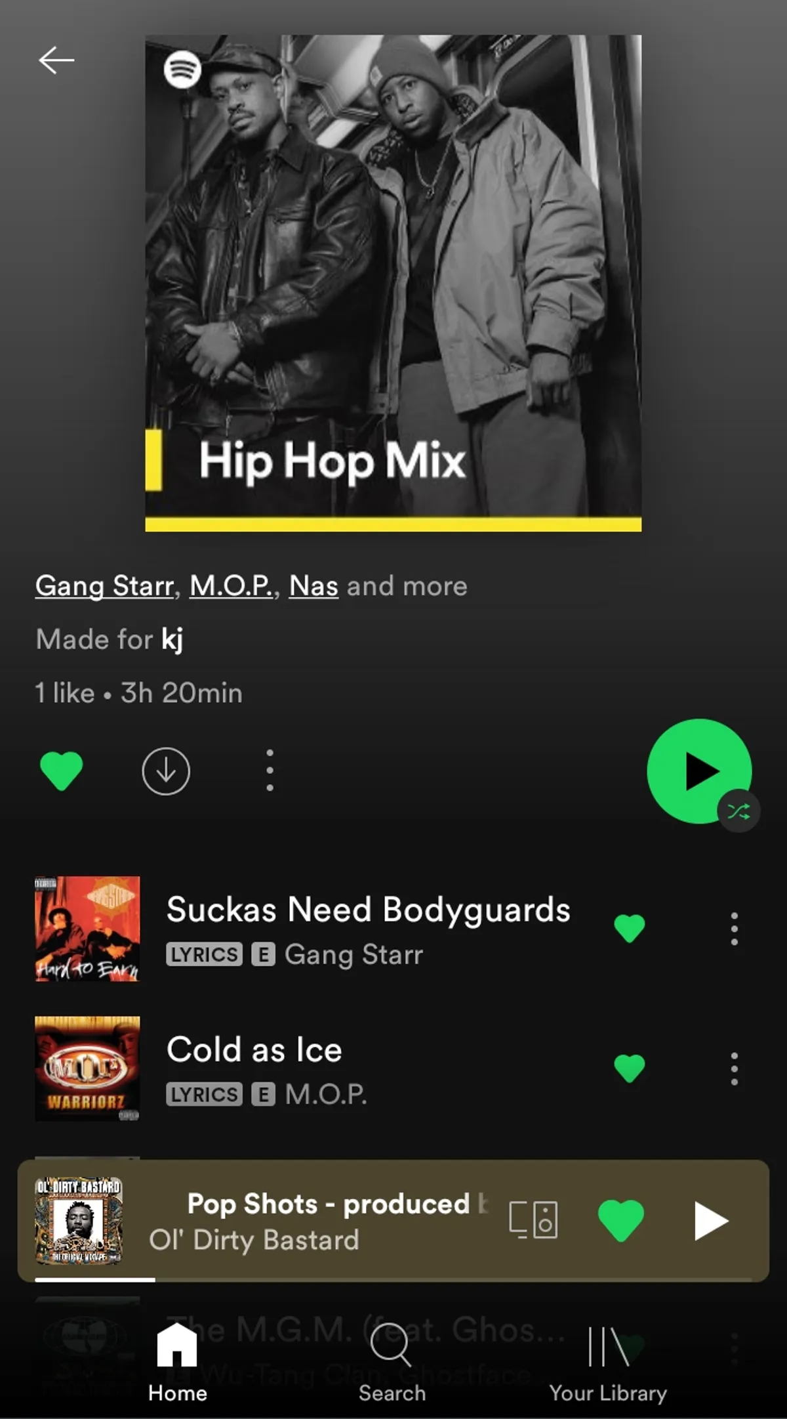
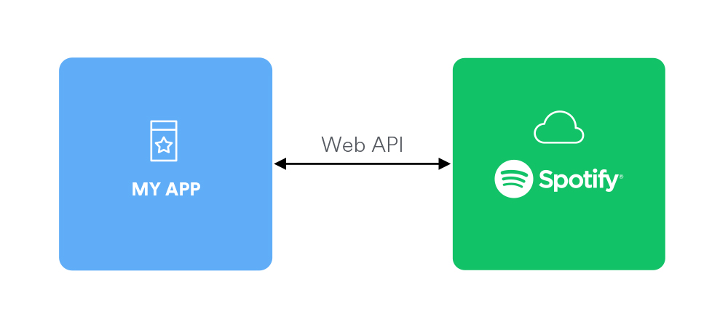
Introduction
Spotify is a digital music, podcast, and video service that gives you access to millions of songs and other content from creators all over the world.
SpotiPy – is an API for spotify implemented in python language. It allows users to create a custom app with it’s own functions.

Slide 4
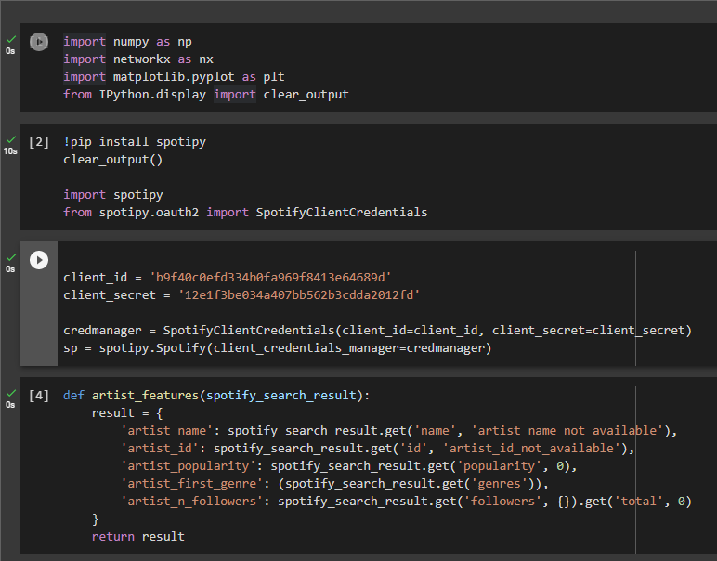

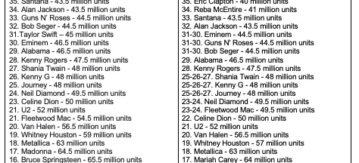
Data acquisition
SpotiPy, spotify API

Slide 5
Prerequisites
Libraries used:
Networkx
Matplotlib
Numpy
Spotipy

Slide 6
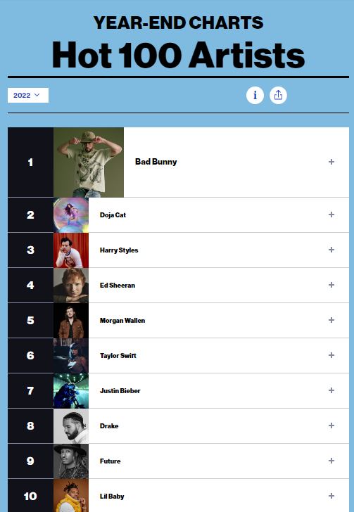

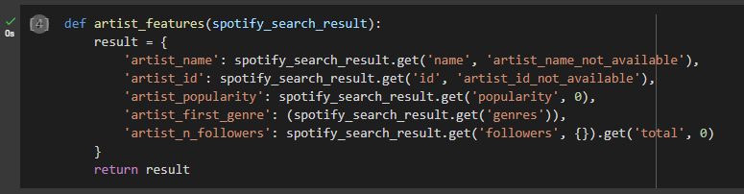
Artists
Spotify’s official top 100 hot artists of 2022 were taken as
a start point for our network
Defining a function we can get artist’s name, popularity, genre
and number of followers

Slide 7
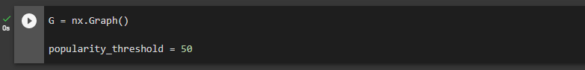
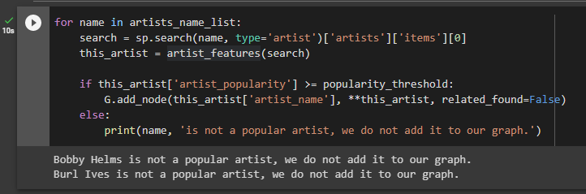
Network
100 artists were added to a network as a initial nodes.
Popularity threshold of 50 was applied.

Slide 8
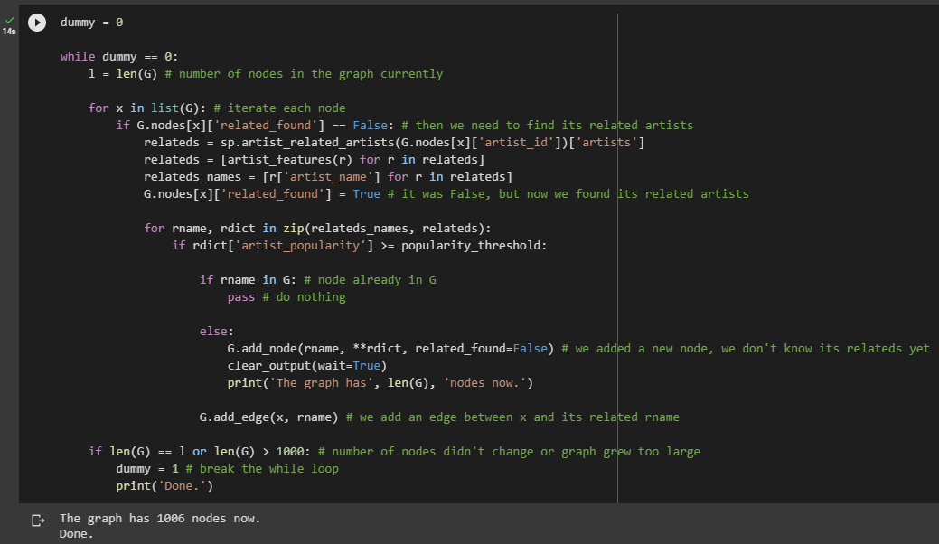
Network
Starting from 100 nodes, each new featured artist is added to a node.
Repeat
Network of 1006 nodes.

Slide 9
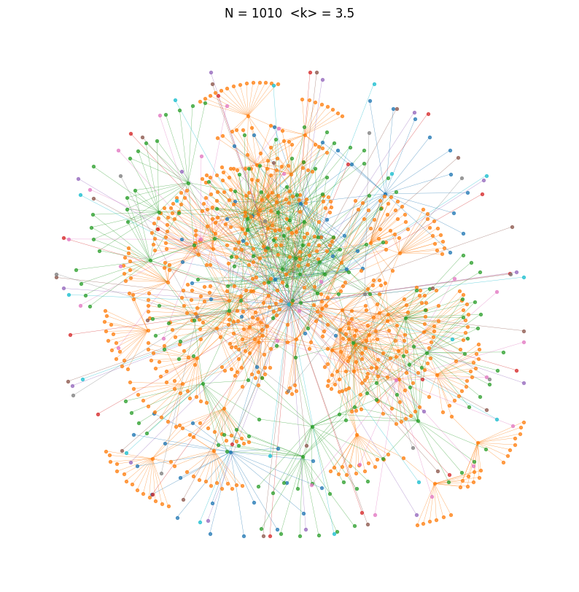
Network
Random _layout
Kamada_kawai_layout

Slide 10
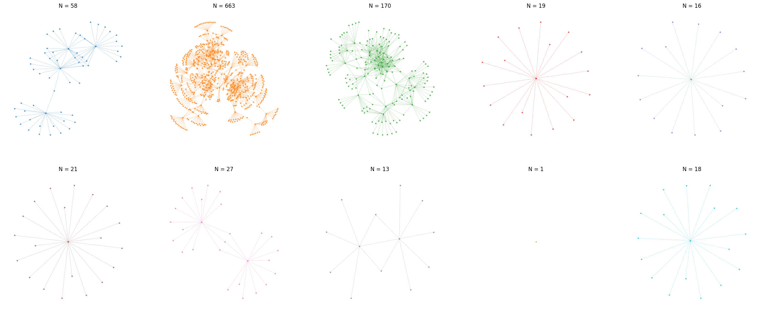
Network
Kamada_kawai_layout

Slide 11
Measurements
Number of nodes
N = 1006
Number of links in the graph:
L = 1782
Average path length of each component:
1 <d> = 3.2867513611615244
2 <d> = 6.025723047759657
3 <d> = 3.703028193525931
4 <d> = 1.894736842105263
5 <d> = 1.875
6 <d> = 1.9047619047619047
7 <d> = 2.6666666666666665
8 <d> = 2.076923076923077
9 <d> = 0
10 <d> = 1.8888888888888888
Clustering coefficient of the network:
C = 0.15446101811698842

Slide 12
Measurements
Expected value of the C for G:
Crand = 0.0035251179490222843
Average clustering coefficient of nodes with degree k in G:
C<0> = 0.0000 C<1> = 0.0000 C<2> = 0.4149 C<3> = 0.4342 C<4> = 0.3455 C<5> = 0.3739 C<6> = 0.4578 C<7> = 0.3492 C<8> = 0.1905 C<9> = 0.5648 C<10> = 0.6222 C<11> = 0.4182 C<12> = 0.2955
C<13> = 0.1838 C<14> = 0.0000 C<15> = 0.0000 C<16> = 0.0000 C<17> = 0.0074 C<18> = 0.0345 C<19> = 0.0385 C<20> = 0.0789 C<21> = 0.1139 C<22> = 0.1494 C<23> = 0.2767 C<24> = 0.2645 C<25> = 0.1967

Slide 13
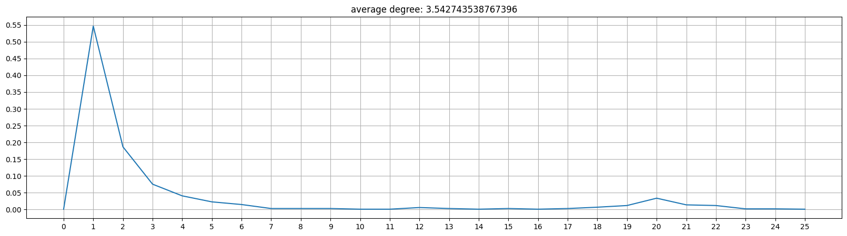
Measurements
Average degree of G: k = 3.542743538767396

Slide 14
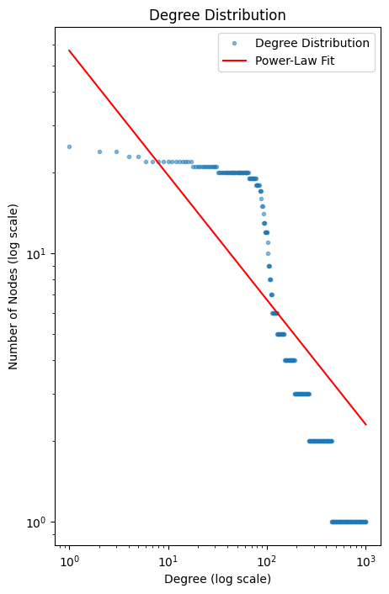
Measurements
Average degree of G: k = 3.542743538767396

Slide 15
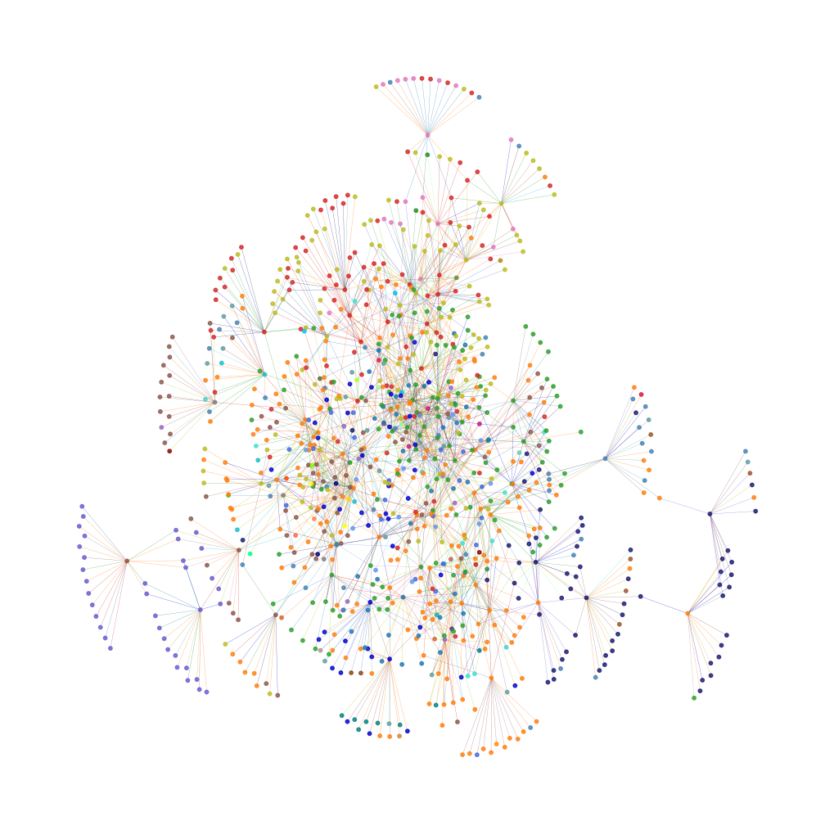
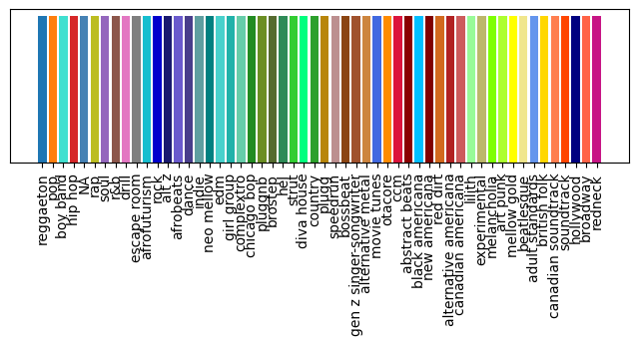
Genre
Color coded graph for corresponding genre of 54 genres.

Slide 16
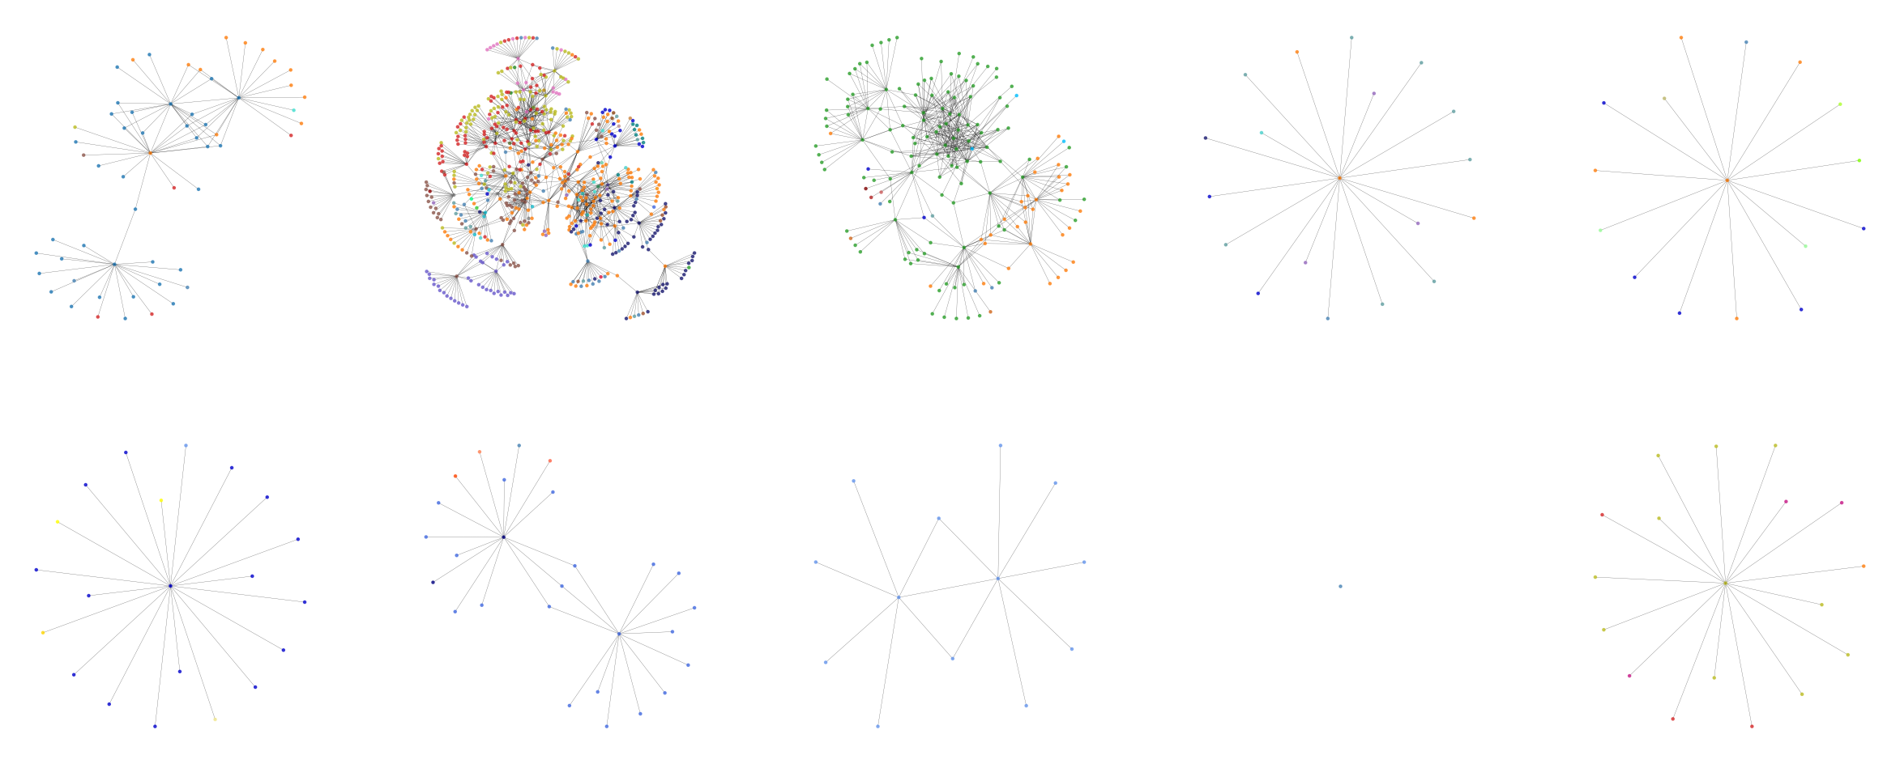
GENRE
Color coded components of graph G for corresponding genre of 54 genres.

Slide 17
GENRE
Color coded components of graph G for corresponding genre of 54 genres.
G[1]N: = 58
G[1]L = 79
G[1]k = 2.72413793103
G[1]<d> = 3.2867513611615244

Slide 18
GENRE
Color coded components of graph G for corresponding genre of 54 genres.
G[2](N): = 663
G[2]L = 1134
G[2]k = 3.420814479638009
G[2]<d> = 6.025723047759657

Slide 19
GENRE
Color coded components of graph G for corresponding genre of 54 genres.
G[3](N): = 170
G[3]L = 457
G[3]k = 5.376470588235295
G[3]<d> = 3.703028193525931

Slide 20
GENRE
Color coded components of graph G for corresponding genre of 54 genres.
G[4](N): = 19
G[4]L = 18
G[4]k = 1.894736842105263
G[4]<d> = 1.894736842105263

Slide 21
GENRE
Color coded components of graph G for corresponding genre of 54 genres.
G[5](N): = 16
G[5]L = 15
G[5]k = 1.875
G[5]<d> = 1.875

Slide 22
GENRE
Color coded components of graph G for corresponding genre of 54 genres.
G[6](N): = 21
G[6]L = 20
G[6]k = 1.9047619047619047
G[6]<d> = 1.9047619047619047

Slide 23
GENRE
Color coded components of graph G for corresponding genre of 54 genres.
G[7](N): = 27
G[7]L = 28
G[7]k = 2.074074074074074
G[7]<d> = 2.6666666666666665

Slide 24
GENRE
Color coded components of graph G for corresponding genre of 54 genres.
G[8](N): = 13
G[8]L = 14
G[8]k = 2.1538461538461537
G[8]<d> = 2.076923076923077

Slide 25
GENRE
Color coded components of graph G for corresponding genre of 54 genres.
G[9](N): = 1
G[9]L = 0
G[9]k = 0.0
G[9]<d> = 0

Slide 26
GENRE
Color coded components of graph G for corresponding genre of 54 genres.
G[10](N): = 18
G[10]L = 17
G[10]k = 1.8888888888888888
G[10]<d> = 1.8888888888888888

Slide 27
Conclusion
What
Can I
Say
Based on the given information, we can say that the network has 1006 nodes and 1782 links, which suggests a relatively dense and connected network.
The average path length of each component varies across components, with some components having a relatively short average path length (e.g., 5<d>=1.875) and others having a longer average path length (e.g., 2<d>=6.025).
The clustering coefficient of the network (C=0.154) suggests that the network has a moderate level of clustering, meaning that nodes tend to be connected to their neighbors.
The expected value of the clustering coefficient for a random graph with the same number of nodes and links as the given network (Crand=0.0035) is much smaller than the observed clustering coefficient, which suggests that the network has a non-random structure.
This indicates that the network has a degree-dependent clustering structure, meaning that nodes with more connections tend to be more closely connected to each other
Overall, the C<k> values suggest that the network has some degree of clustering, with higher clustering among nodes with intermediate degree values, which is consistent with the high overall clustering coefficient of the network.
These observations are generally consistent with the properties we would expect to see in a social network or other network with a similar structure

Slide 28
Conclusion
Rock, Country, Adult
HipHop, Drill, pop, etc
Others
As we saw in our components that were color coded based on the genre, these genres tend to be more isolated from other genres.
On the other hand, these genres are more connected to each other, allowing a lot of featuring between artists of different genres.
Since artists are not married to a certain genre, we see some special cases of rock being bound to pop. These cases are just outliers of how artists change their genre and which artists they work with.

Slide 29
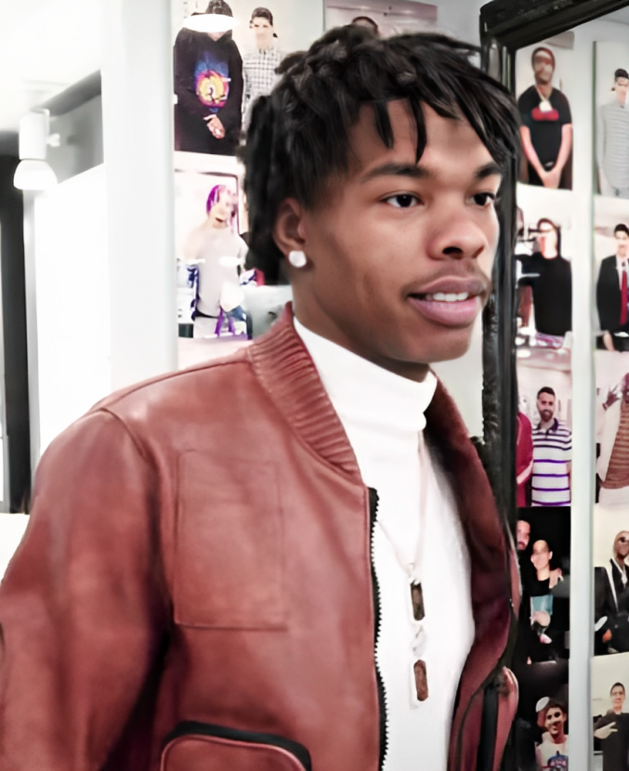


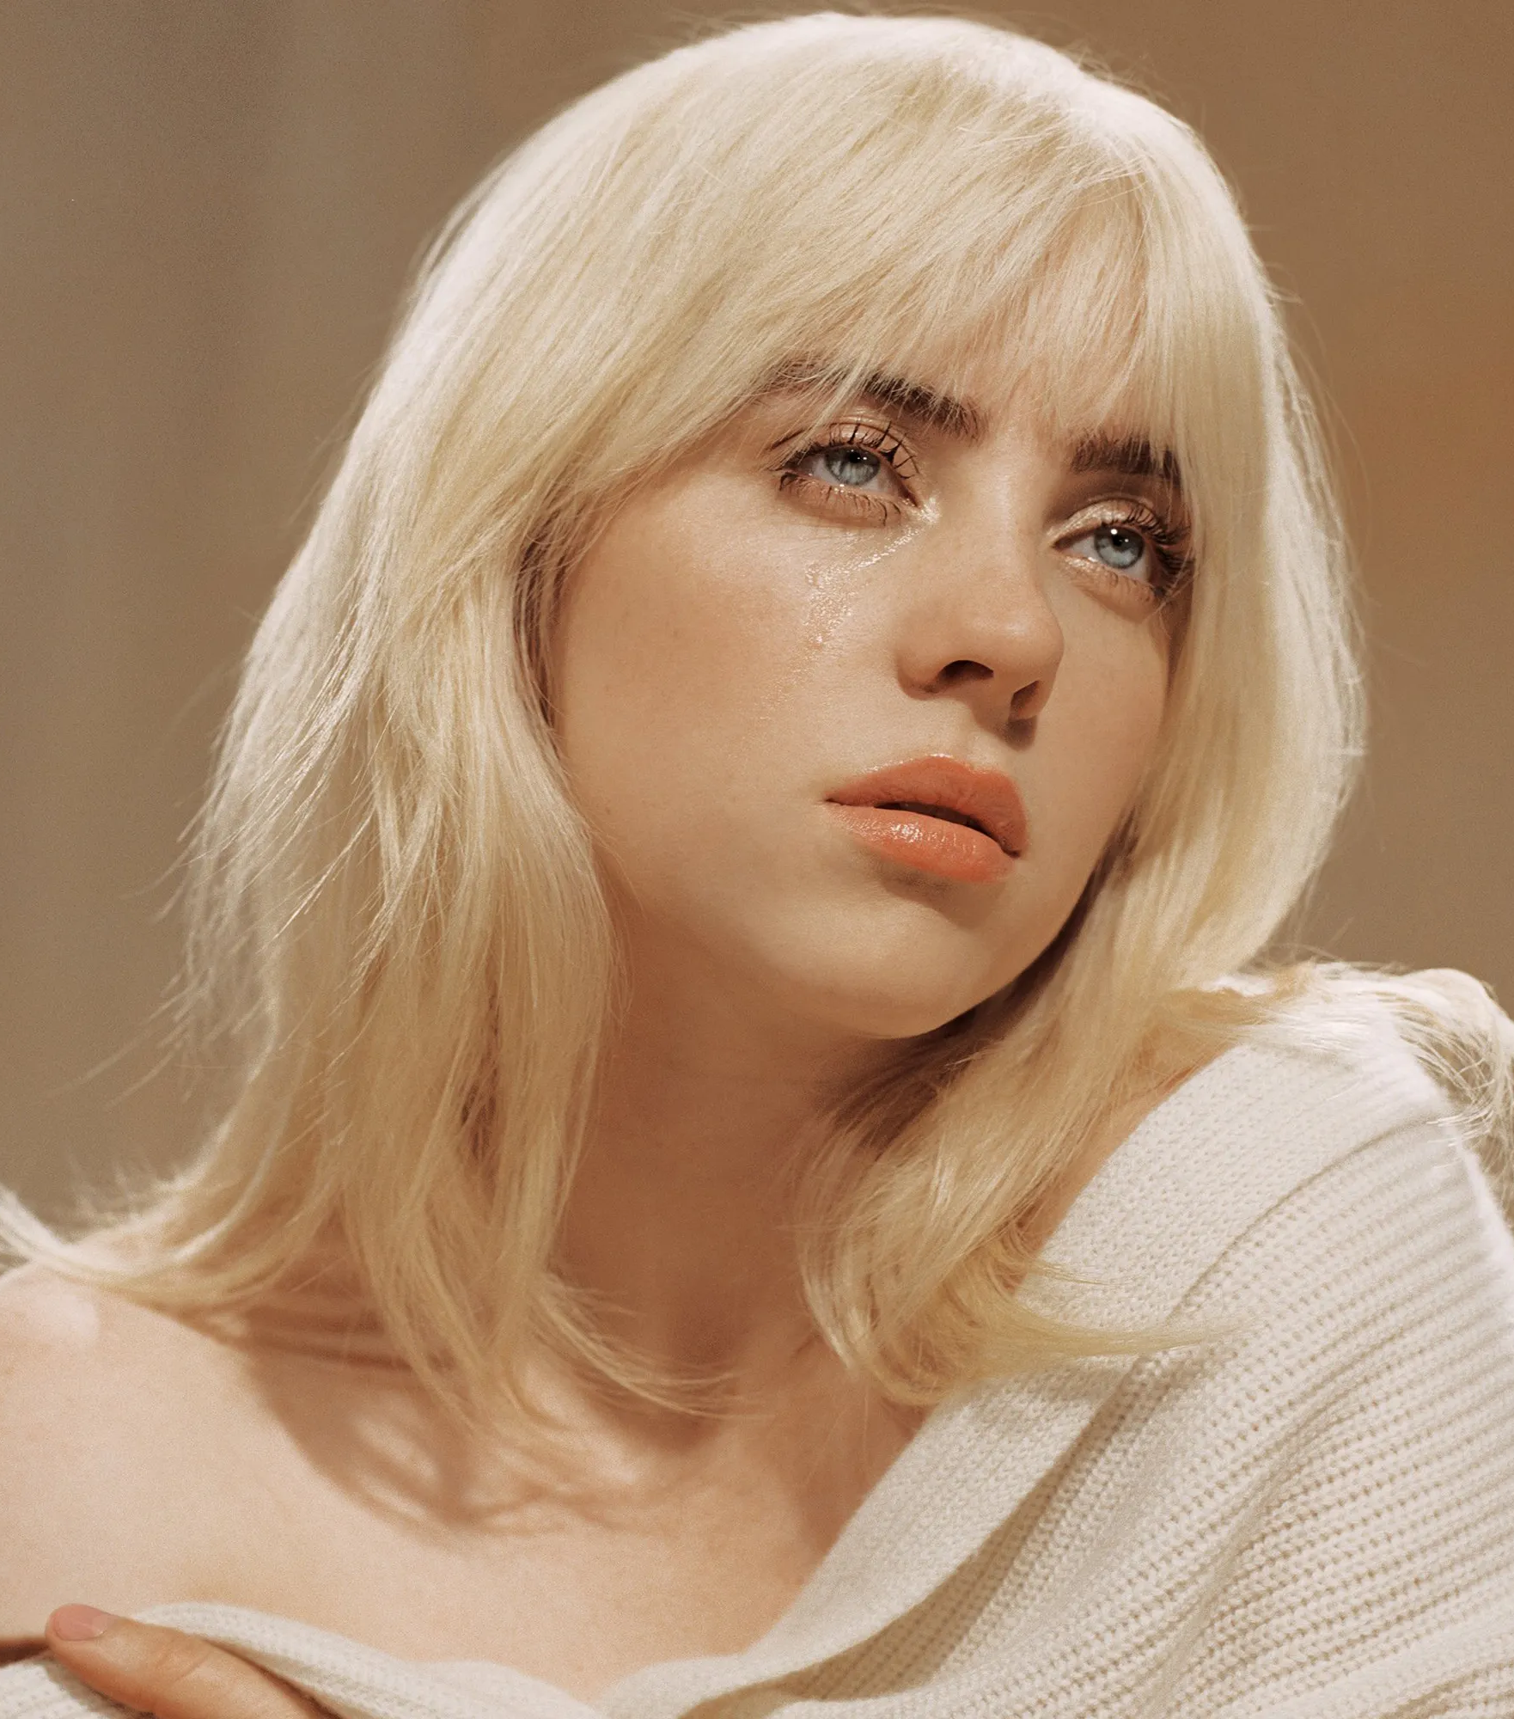
Expectations / Results
My favourite artists :D
A network of artists being relatively closely connected and non-random, as we covered in our lectures, was expected and these expectations were met.
Personally, I was expecting these results, because as an old fish in a music industry fish tank, I know pretty handful of stuff about music artists.
It was a lot of fun coding and visualizing and I am happy I didn’t have to calculate everything on the paper.
Lil baby
Вектор А (vector A)
Future
Billie eilish

Slide 30
Limitations
Despite Networkx being a very useful tool, visualization options are not the best, along with the matplotlib being hard to work with networkx. Some of data couldn’t be visualized as I wanted. (genre color coding, legends and more explanations.)
Spotipy is a great tool, however, a lot of mistakes were encountered. Such as, genre being not found.

Slide 31
Thank you
Google colab notebook: https://colab.research.google.com/drive/1C_6_E_OuKIzO0FQsdqsDKeUIJOy3g4Am?usp=sharing

